Slide 1
Before you begin…
Read the following two articles/chapters in D2L
1. Creating and Effective Assignment
2. Teacher-made Test Formats
Email me with any questions you have: chandlet@email.arizona.edu

Slide 2
Validity in Tests
CATT Program:
Tara Chandler: Assessment Module Instructor

Slide 3
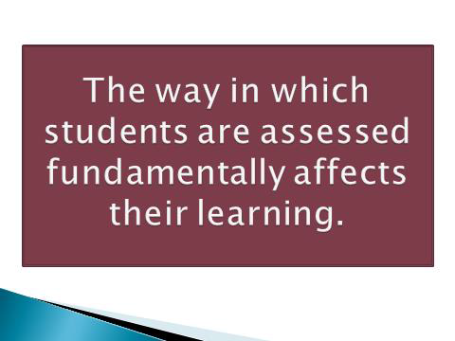
Review: Principles of Assessment- Week 1

Slide 4

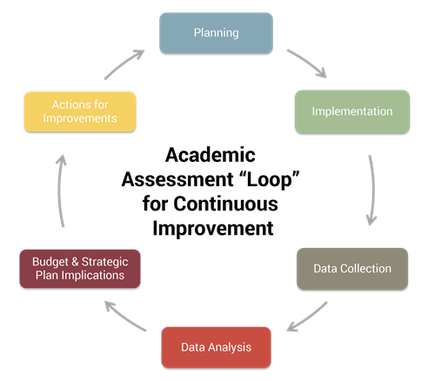

Slide 5

The goal of assessment has to be, above
all, to support the improvement of
learning and teaching.
(Frederiksen & Collins, 1989)

Slide 6
The Basic Principles of Assessment:
The Five Cardinal Criteria

Slide 7
Key Assessment Principles
1. Validity - Does the assessment measure what we really want to measure?
2. Reliability- Is all work being consistently marked to the same standard?
3. Practicality - Is the procedure relatively easy to administer?
4. Washback - Does the assessment have positive effects on learning and teaching?
5. Authenticity - Are students asked to perform real-world tasks?

Slide 8

Remember, the most important of them all is validity.
Does the assessment measure what we really want to measure?

Slide 9
You are a content teacher. Your assessments should measure content, not English language ability.
Although in your daily teaching you will be modeling correct use of English and providing some feedback on use of English, to keep your assessments valid, test content.
This may mean you test content in Russian and not in English.

Slide 10

__________ is perhaps the most critical of all teaching skills.
Decision-making

Slide 11

Good assessments lie at the core of good decision making.

Slide 12
j
Think about assessments you have given in the past:
Think of an assessment success, what was valid about that test?
Think of an assessment that did not go well, was it valid?
If validity is not established, all other considerations may be rendered useless.

Slide 13

Types of Tests
The ideas for the following slides are taken from the following source:
A Practical Guide to Assessing Language Learners (Coombe, Folse &Hubley, 2007) copyright University of Michigan

Slide 14
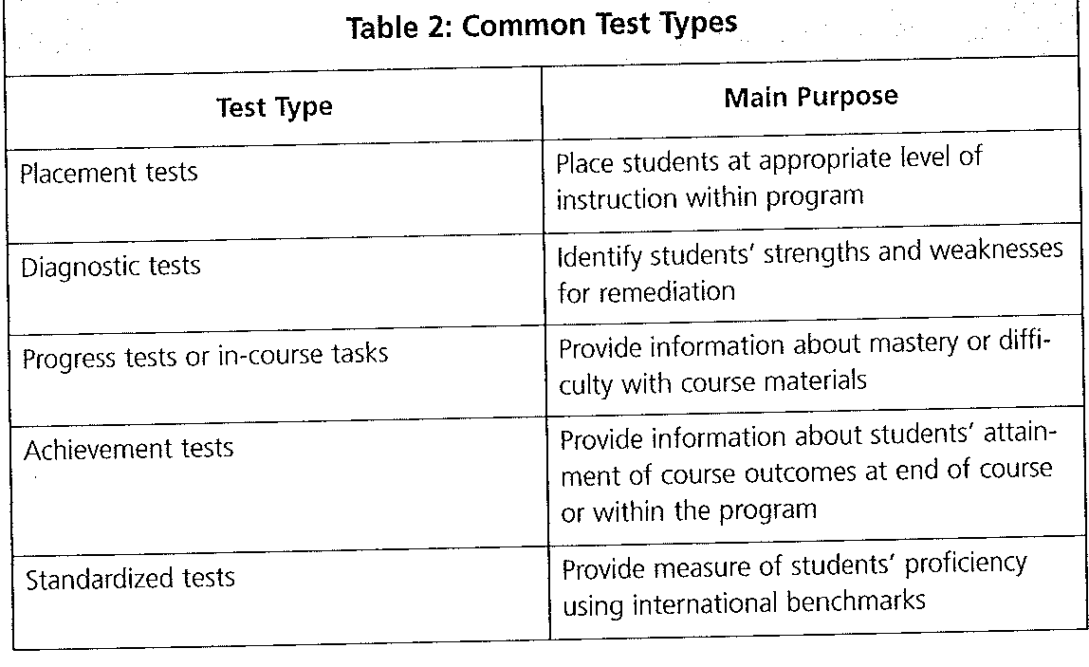

Slide 15

Because you are an EMI/Content teacher…
We will only focus on the following three types of tests:
Diagnostic Tests
Progress Tests
Achievement Tests

Slide 16
Diagnostic Tests
Purpose: To identify the student’s English language ability
Application: Provide a test early in the semester to assess the English language ability of your students. This information can help you determine the level of EMI you will use in your classroom
Example: Ask students to read an article independently and write a summary of the ideas.

Slide 17

Diagnostic Tests
The information you gain from this test can help you determine:
How much English to use in your lessons
How much scaffolding to provide
How you will need to modify/create materials in your content area

Slide 18
Diagnostic Tests
This same information of the students’ level of English fluency might be available from their English language instructor making it unnecessary for you to do your own diagnostic.
This information might also be available from a previously taken placement or standardized test of English (see Table 2 on slide 14)

Slide 19

Progress Tests or In-course Tasks
Purpose: To provide information about mastery or difficulty with course materials
Application: This can be a test or an alternative assessment:
Examples: 1. A test in English or Russian or both of a chapter/unit covered in your content area. 2. A project applying concepts taught in a chapter/unit.

Slide 20

Progress Tests or In-course Tasks
Next week, we will focus more on alternative assessments and using rubrics to score them with reliability.
For the rest of today’s lesson, we will focus specifically on tests.

Slide 21
Progress Tests
Allowing student to test in both languages is good when possible.
Bilingual/multilingual testing when possible = more accurate testing. It is more valid since it is easier to know how much content knowledge students have rather than students being assessed on language use.
It’s probable that students with higher proficiency in English will score better on English only tests (rather than bilingual) since it can be difficult to think about language use and expression of knowledge of content
(Van der Walt & Kidd, 2013)

Slide 22

What conclusion can we draw from this information?
Knowing the English proficiency level of your students will help you to make better choices for following assessments.

Slide 23

More on EMI-based testing…
Just as you modify materials when teaching content, it is ok to modify your assessment materials (if in English).
Using modified materials (in a relatively controlled study) on an English-only test probably helped students whose home language was not English.
(Van der Walt & Kidd, 2013)

Slide 24

Progress Tests
Again, the purpose of progress tests throughout the semester is to provide information about mastery or difficulty with course materials.
Therefore, progress tests are formative assessments.
Formative assessments are meant to provide information to guide teacher instruction and to give students an opportunity to get feedback from the instructor.
(Coombe, Folse &Hubley, 2007)

Slide 25
Having a variety of forms of assessments (tests, projects, portfolios, presentations, etc.) throughout a semester gives a more accurate depiction (validity) of each student’s content knowledge.
Why do you think this is so?

Slide 26

Achievement Tests
Purpose: Provide information of students’ attainment of course outcomes at end of course or within a program
Application: Final Exam or an alternative Final Assessment

Slide 27


Achievement Tests
The EMI-based principles for progress tests also apply to achievement tests.

Slide 28

Achievement Tests
Achievement tests are formative assessments.
Formative assessments are meant to inform the instructor whether the student has met the objectives set out in the curriculum
Formative assessments are given at the end of a course.

Slide 29
Review
Diagnostic Test
Progress Tests
Achievement Test
EMI-based assessment principles

Slide 30
To sum it all up…
How can you maintain validity in your tests?
Describe the three types of tests discussed in today’s lesson.
What are some important principles to consider when deciding how much English/Russian to use in your assessments?

Slide 31
Questions?
Do you have a question?
Please email me at chandlet@email.arizona.edu

Slide 32
Thanks!
Thanks so much for viewing this lesson. I look forward to discussing with you in the Week 2 Discussion Board!

